Slide 1
Introduction to RESTful Services
Week 06.

Slide 2
Objectives
Describe the HTTP methods and CRUD operations
Demonstrate how to test a RESTful API

Slide 3
Tools Required
Postman
Chrome Browser

Slide 4
RESTful API

Slide 5
What is an API?
API stands for Application Programming Interface
A set of routines, protocols, and tools for building software applications
A software intermediary that allows two applications to talk to each other

Slide 6
What is a RESTful API?
REST stands for Representational State Transfer
Software architecture style that relies on a stateless communications protocol, most commonly HTTP
It can be used to manipulate data in any programming languages e.g. Java, JavaScript
Data can be structured in different formats such as HTML, XML, plain text, JSON etc…

Slide 7
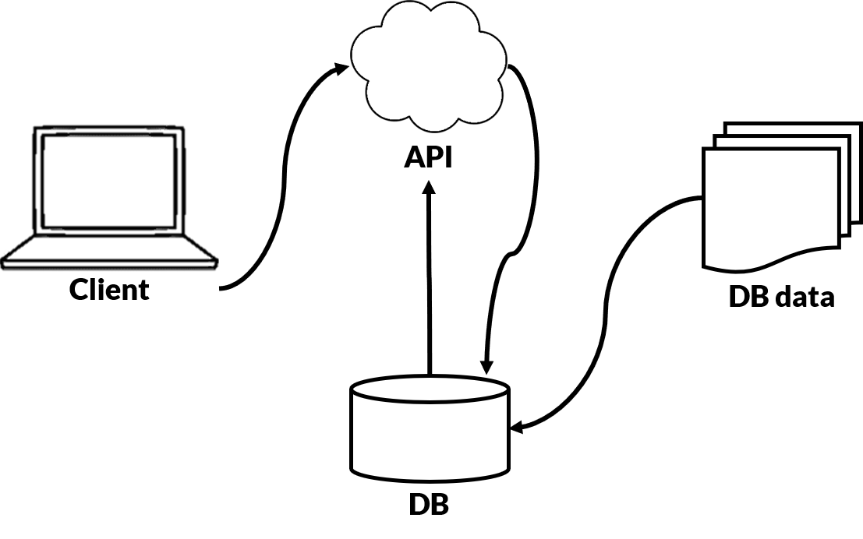
What is a RESTful API?

Slide 8
HTTP Methods
RESTful APIs can be used to implement Create, Read, Update, and Delete (CRUD) operations
HTTP Verb | CRUD | Operations
POST | Create | To “create” or “insert” new data into the database
GET | Read | To “read” or “retrieve” data from the database
PUT | Update | To “update” or “overwrite” data in the database
DELETE | Delete | To “delete” data in the database

Slide 9
JSON Data
JSON is one of the common data structure used by REST
JSON: JavaScript Object Notation
Data is in name/value pairs
Data is separated by commas
{“name”: “Peter Tan”, “age”: 30}
In this subject, we will be creating REST API to retrieve data from the database in JSON format too

Slide 10
TESTING a restful api

Slide 11
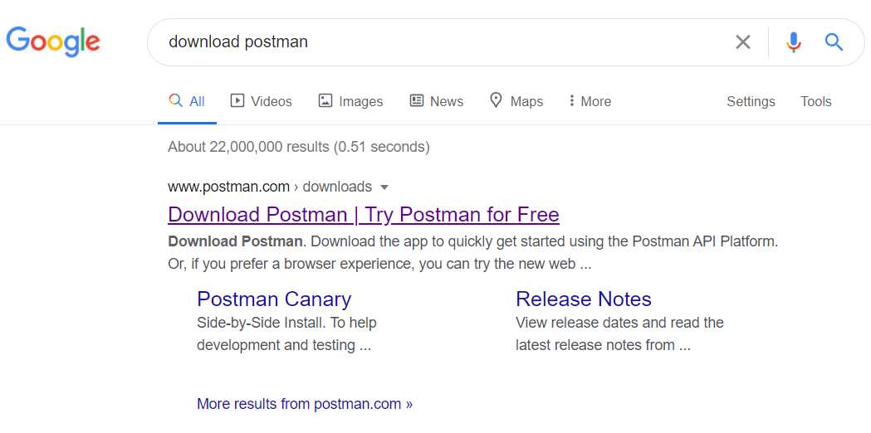
Test REST API
Search for “Download Postman” in the web to download the Postman application
Install Postman after you have downloaded it

Slide 12
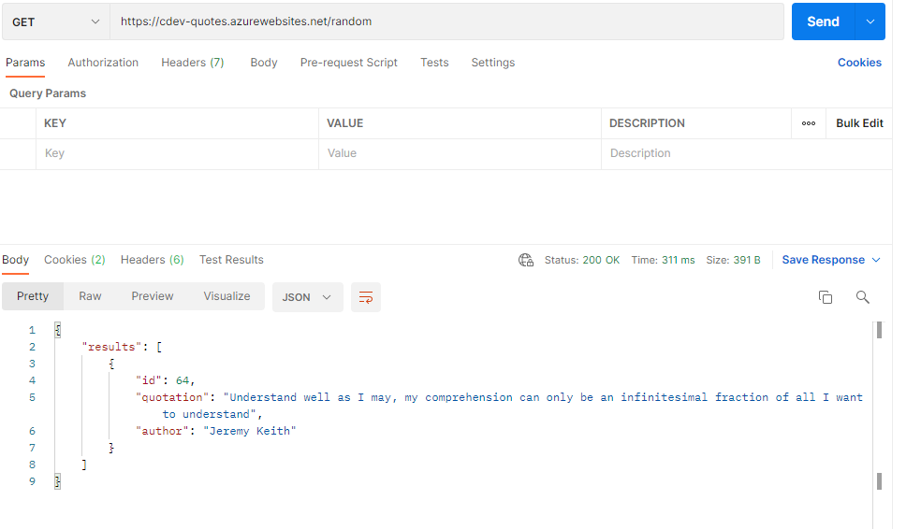
Test it!
Launch the Postman
Select the “GET” function and paste the URL https://cdev-quotes.azurewebsites.net/random
to test the API
Click on the “Send” button

Slide 13
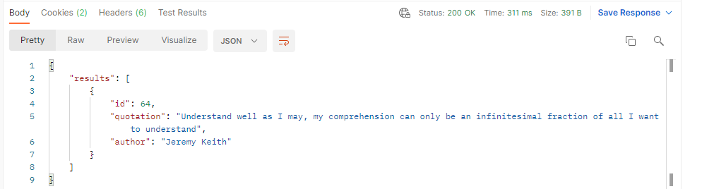
Test it!
You should see the following data in JSON format in the “Body” of the Postman app
When the retrieval of data is successful, you should see a status “200”

Slide 14
Next Episode
In the next episodes, you will learn how to create APIs to read and retrieve data from the database

Slide 15
Reference
TutorialsPoint – Learn REST API
https://www.restapitutorial.com/
REST API Tutorial
https://restfulapi.net/

Slide 16
The End

